Slide 1
Do you value your individualism? Explain
Is important to recognize individual rights? Explain
Is promoting individual self-interest the same as being selfish? Explain
Does promoting self-interest help or hinder society with making progress? Explain

Slide 2
Individualism
Collective

Slide 3
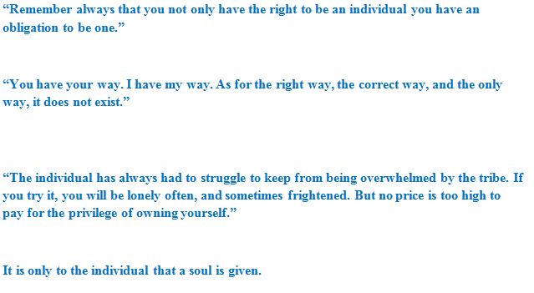
Individualism

Slide 4
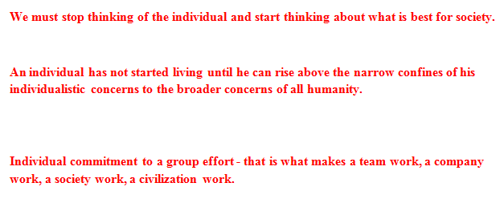
Collectivism

Slide 5
Coordination between Individualism and Society

Slide 6
What quote did your group agree with the most? Explain why
What quote did you group agree with the least? Explain why
Did every person agree or was there disagreement? How did you come up with the group decision?
What types of quotes did you and your group agree with the most? Explain why

Slide 7
Coordination
1. the organization of the different elements of a complex body or activity so as to enable them to work together effectively.
2 : the harmonious functioning of parts for effective results
What coordinates us?

Slide 8
“It is not from the benevolence of the butcher, the brewer, or the baker that we expect our dinner, but from their regard to their own interest.”- Adam Smith
How do this quote represent a coordination between individuals?

Slide 9
“It was just a strange group of unique guys who each suddenly decided that winning the championship was the most important thing in the world to them.”
How do this quote represent a coordination between individuals?

Slide 10
"Ask not what your country can do for you -- ask what you can do for your country."

Slide 11
Is pursuing individual self-interest the same as being selfish?
Explain your answer

